Slide 2
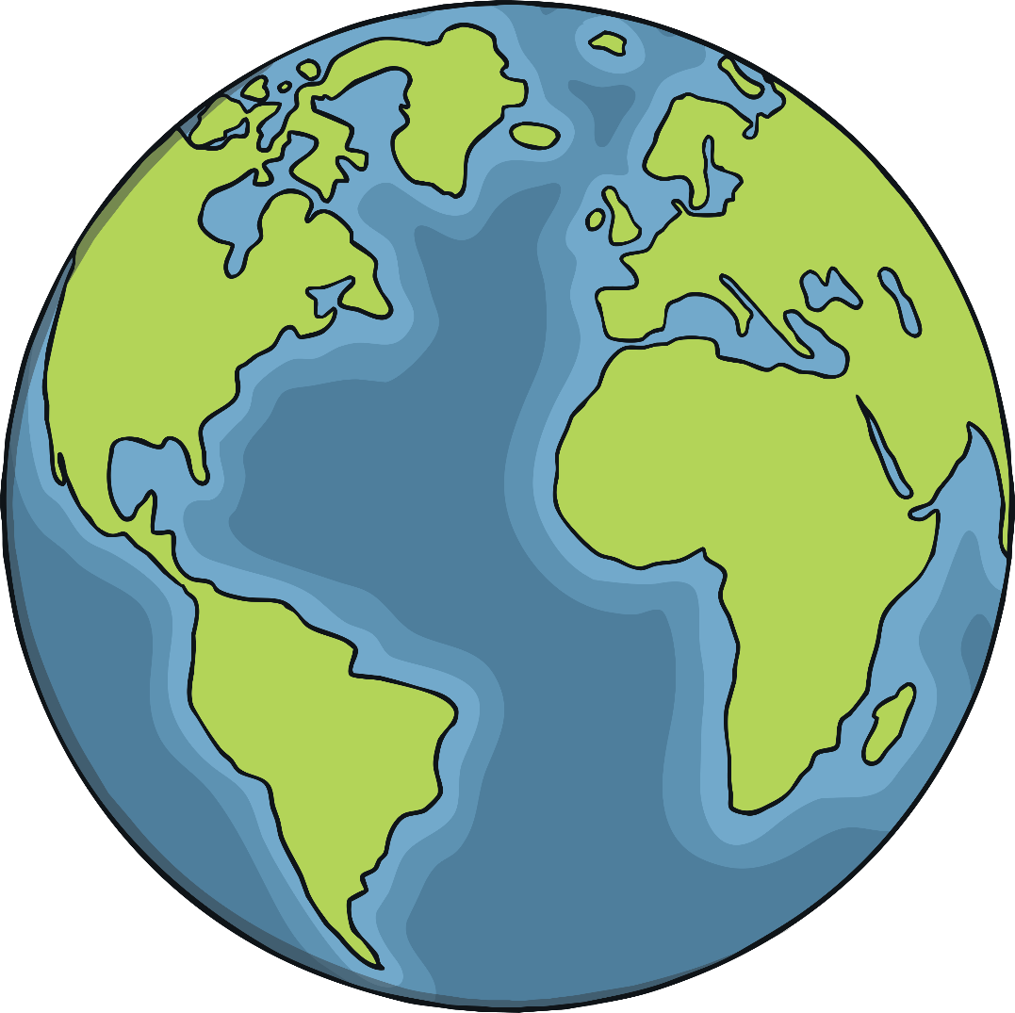
What Is the Water Cycle?
      The water cycle shows the constant
      movement of water within the Earth
      and its atmosphere.
What is the Earth’s atmosphere?
The atmosphere is the layers of gases
that surround Earth. It keeps us warm,
gives us oxygen to breathe, and is
where weather happens.

Slide 3
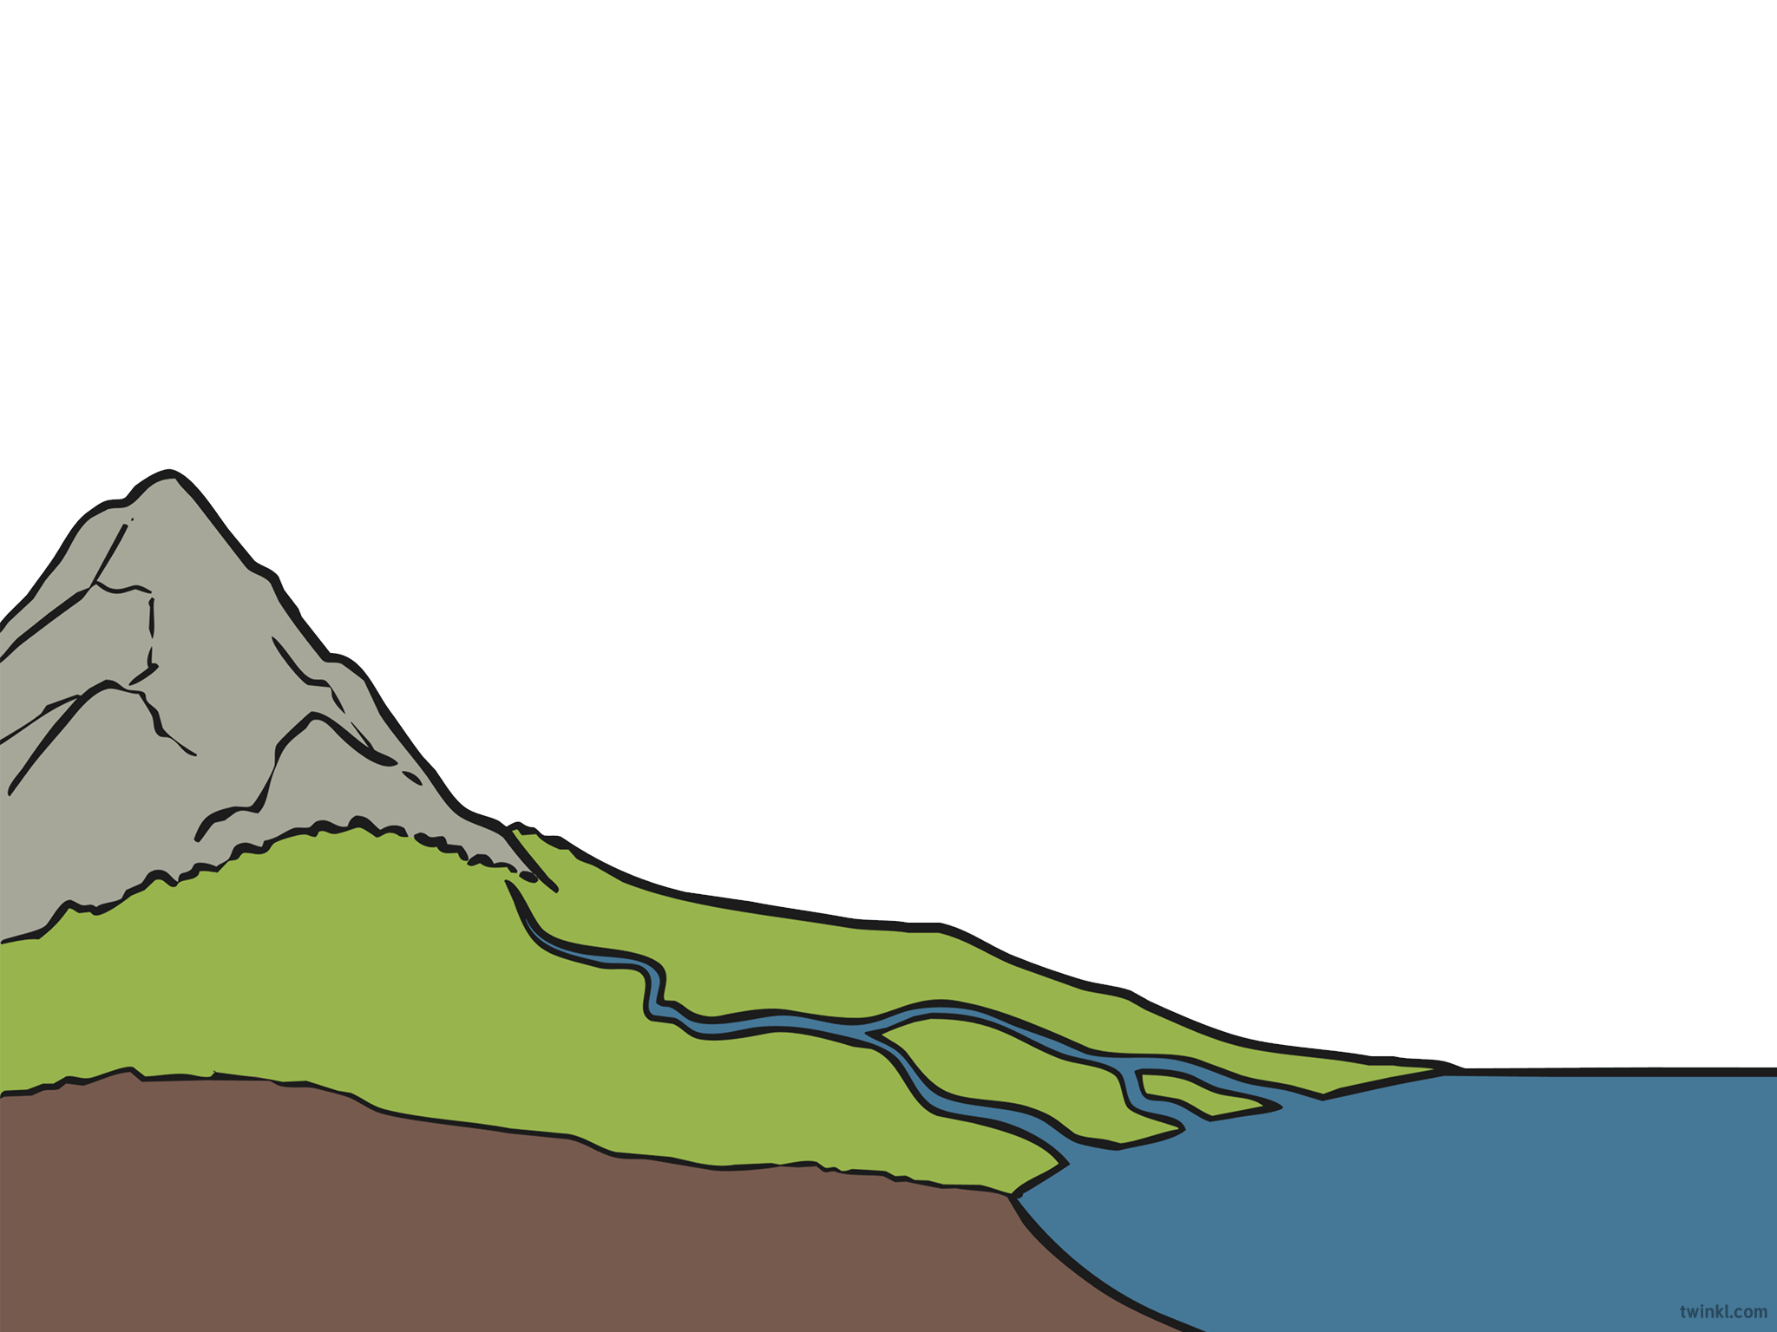
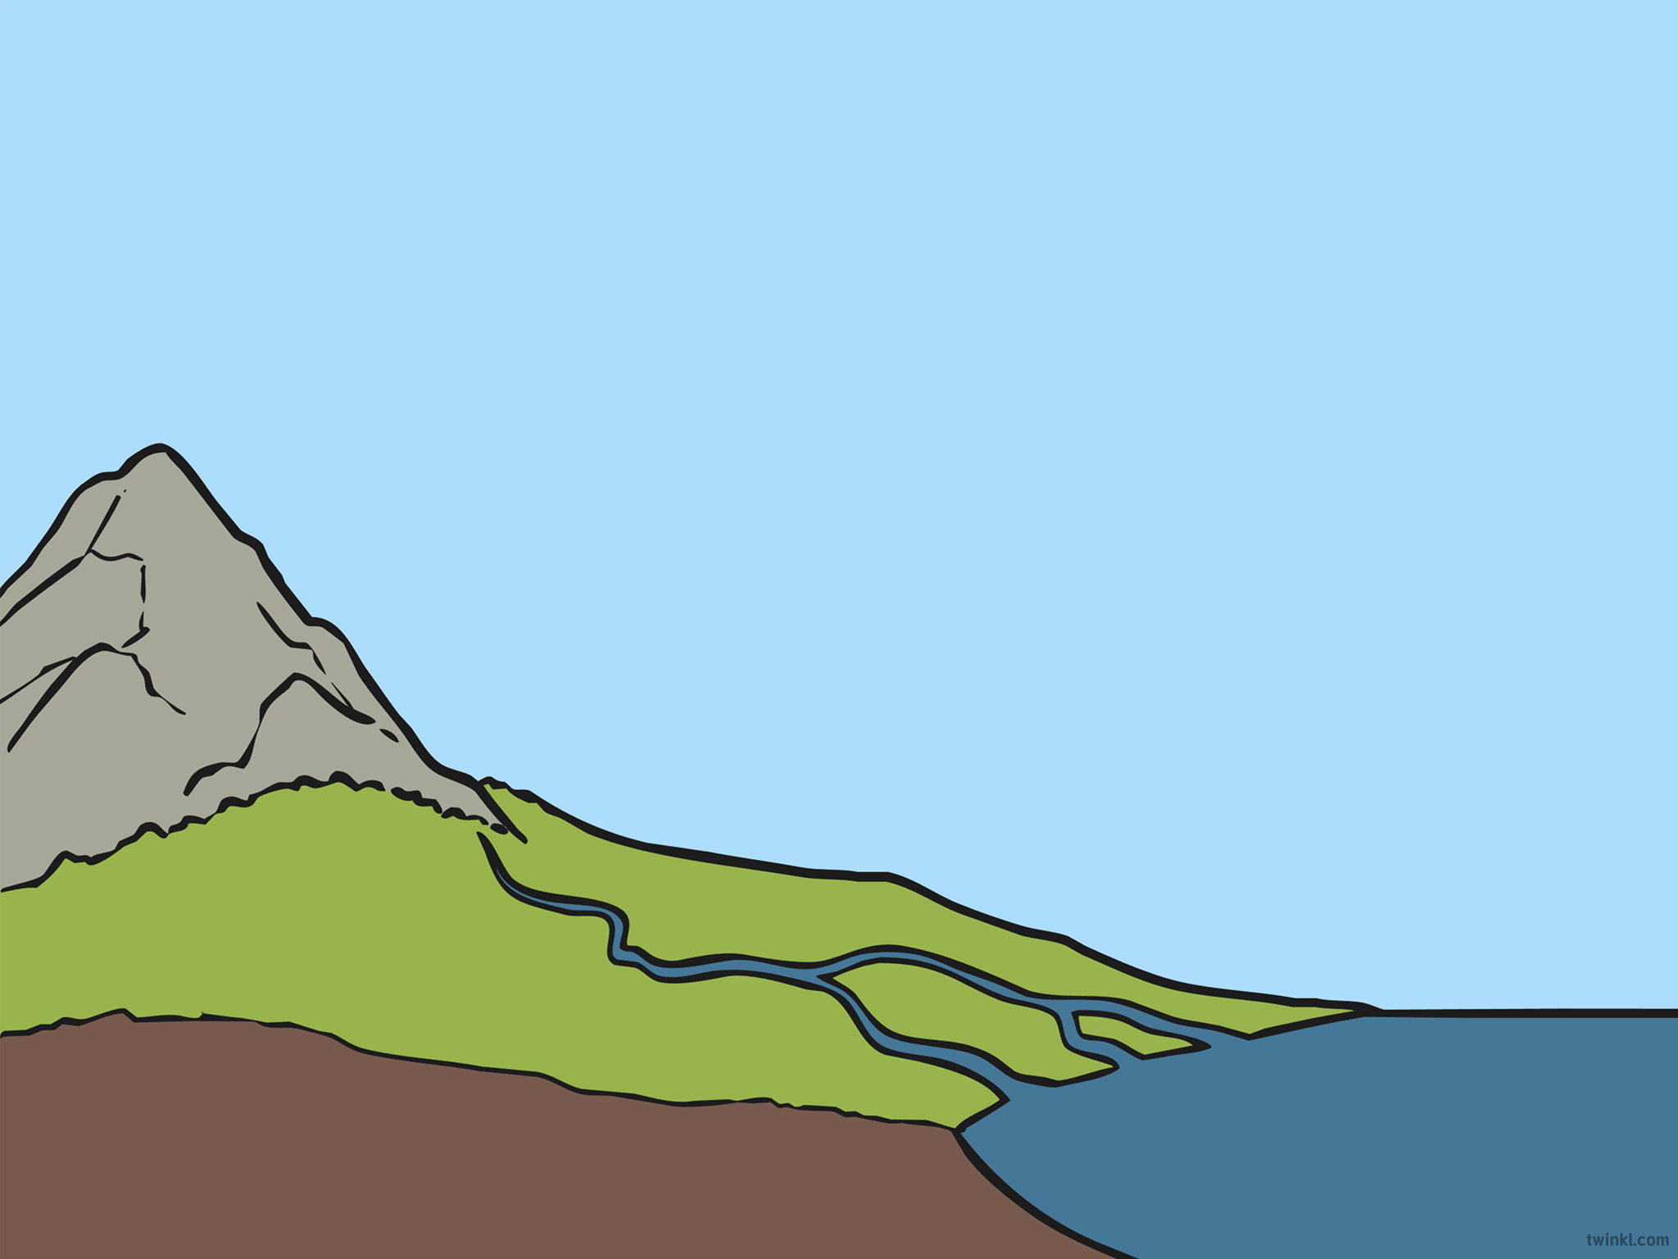

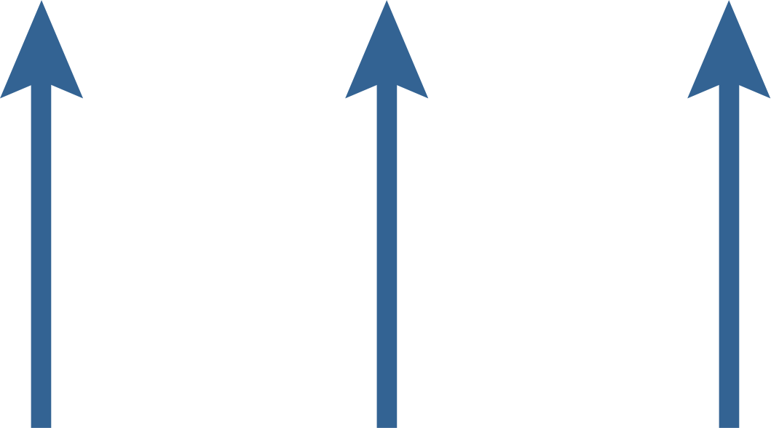
The Sun
The heat of the sun is what makes
the water cycle work.
The liquid water turns into an invisible
gas or vapor during evaporation.
The sun’s heat changes water from the Earth’s oceans into water vapor.
This part of the water cycle is
called evaporation.

Slide 4

What’s Next in the Cycle?
The invisible vapor rises into the atmosphere, where the air temperature is cold.
Condensation is what makes clouds form!
The cold air causes the water vapor to
condense into clouds and water droplets.
  Now the vapor or gas has turned back into liquid form.
This part of the water cycle is called condensation.

Slide 5


The Next Step of the Water Cycle
After the clouds have formed because of condensation, they begin to get heavier and heavier with water droplets.
Precipitation is the water falling from the clouds. Depending on the air temperature, precipitation can be in the form of rain, hail, snow, or sleet.
  When the droplets are heavy enough, they begin to fall from the clouds as precipitation.

Slide 6




The Complete Water Cycle
sun
condensation
precipitation
rivers
evaporation
run-off
ocean

