Slide 1
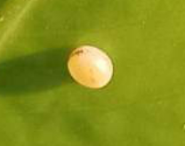
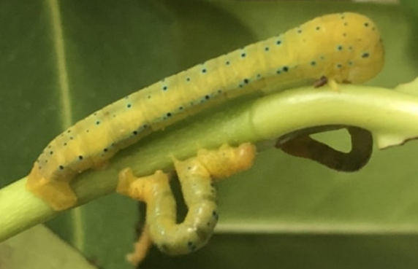
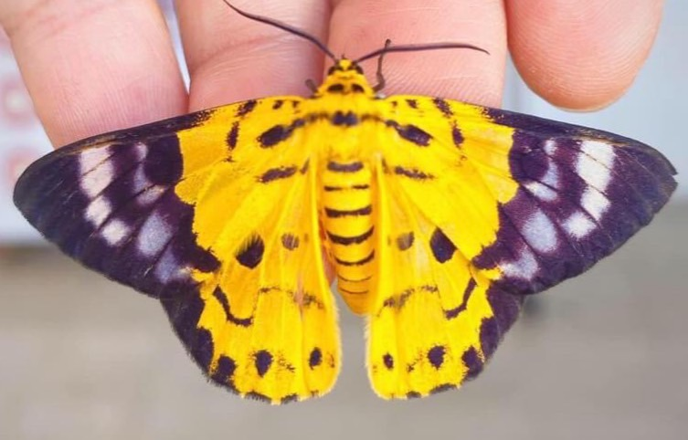
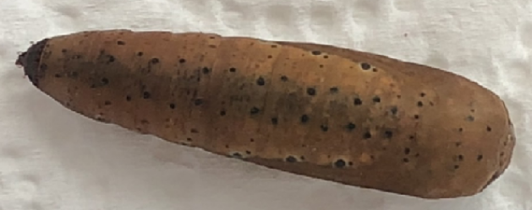
Life Cycle of Military Dysphania Moth (Disphania militaris)
Host Plant: Carallia brachiata (Lour.) Merr
Egg Stage
5 – 7 Days
Larva eating its own eggshell
Caterpillar Stage 28 Days
At this stage, they will move a lot. Their movement is unique. Please be gentle when you touch them, do not pull their leg to hard. Just wait until they release by themselves. This stage is very long, lots and lots of caterpillars are not make it. The survival rate is very low, around 1:5 so please do not panic if you see lots of them dead. It’s the natural selection!
Moth Stage
35 -45 Days
Pupa Stage
30 Days
Female and male moths are very alike except that the female is bigger. After they came out of pupa, please do not touch them right away. Their wings are still wet. This stage is very important, if they can not dry their wings properly, they will be damaged forever. After taking lots of photos, you can let them go as soon as possible. Please leave them under a tree or a branch, help them hide from the hungry birds.
Before caterpillars turn into pupa, they will not eat and move anymore and will release some liquid. Please do not misunderstand that they are dead (No, they are not), please don’t put them away. They are moth so, when they turn into pupa, they will use leaf to wrap around themselves. After all caterpillars turn into pupa. Please put away remain leaves, and put new towel in the box.
FB/IG: บ้านหนอนผีเสื้อ @TheVeryHungryCaterpillarHouse
If you have any further questions, please feel free to contact me. I’m willing to help. And please enjoy.

