Slide 1
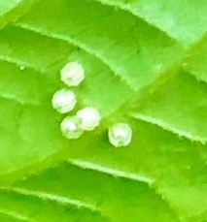
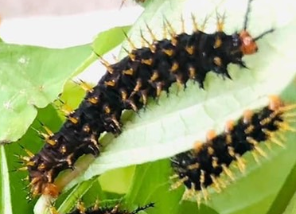
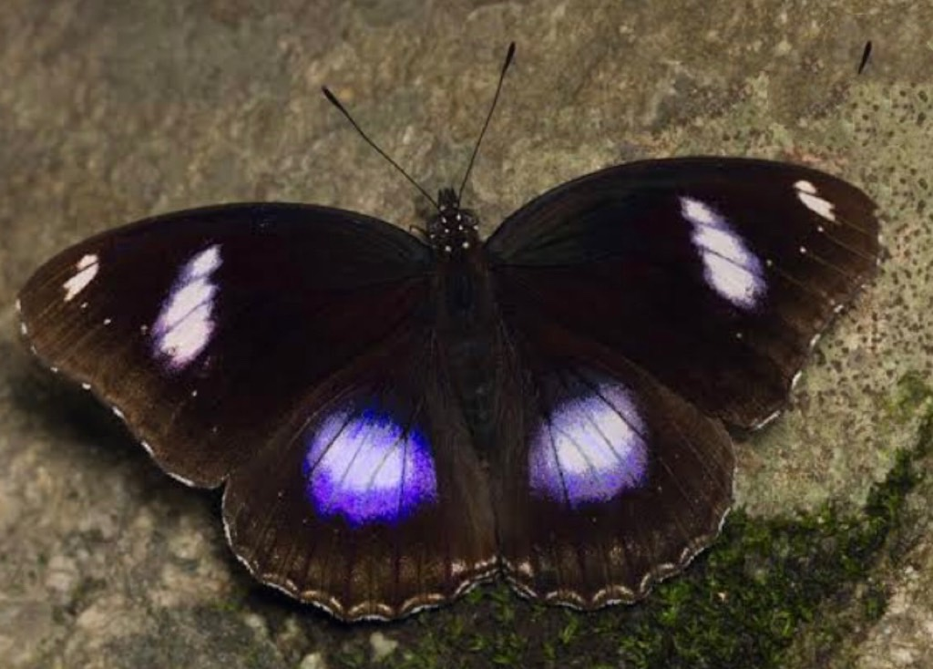
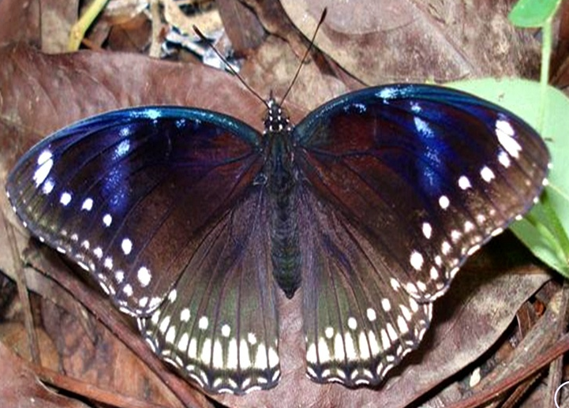
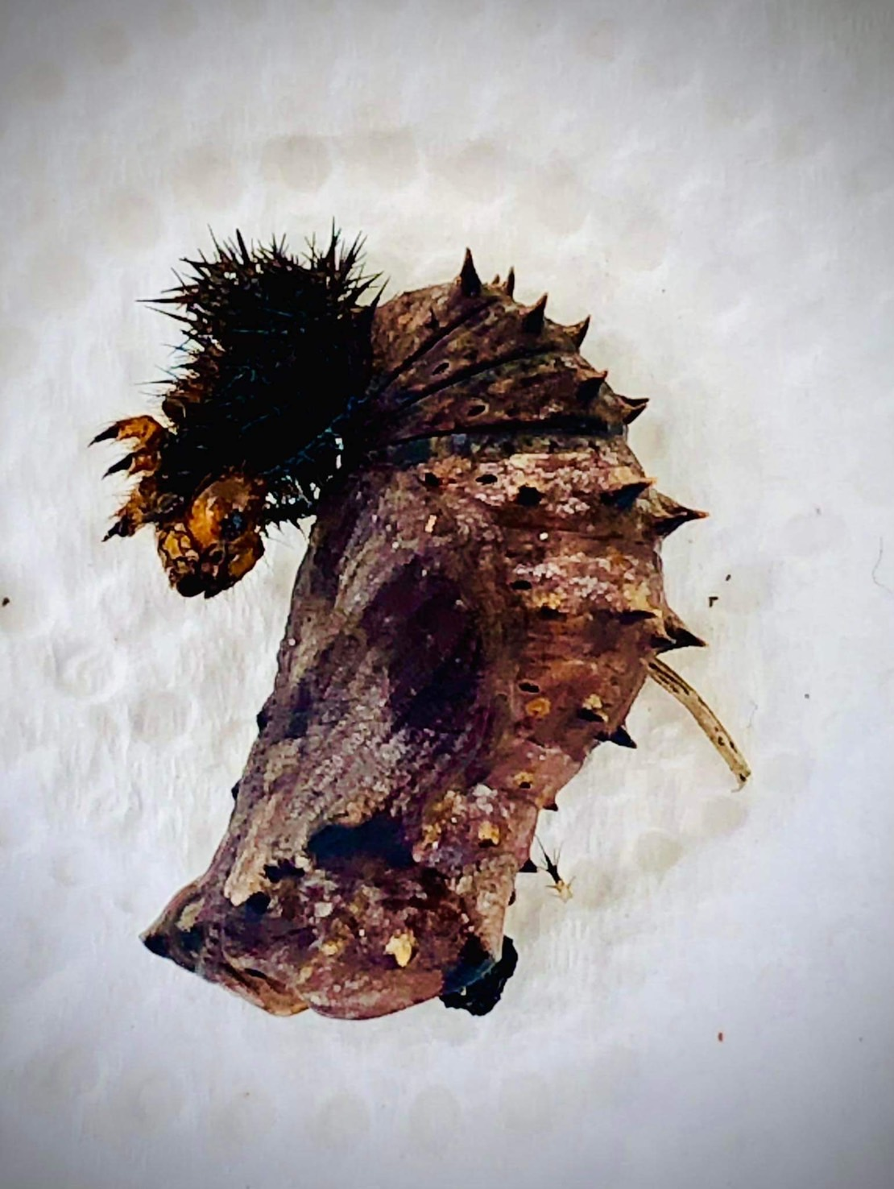
Life Cycle of The Great Egg fly
FB: บ้านหนอนผีเสื้อ @TheVeryHungryCaterpillarHouse
(Hypolimnas bolina)
Egg stage:
3 – 5 days
Caterpillar stage
18 - 20 days
Female butterflies lay eggs on their host plant. When hatched, larva eating its own eggshell
First stage, caterpillars are black with golden thorn, they will be molting their skins for 4-5 times and grow bigger. The last stage, they are black. During caterpillar stage keep feeding them by putting new leaves in the box and empty their stool. Do not left their stool in the box more than 2-3 days because there will be germ and caterpillars will be infected. Last stage, caterpillars will be around 5cm long, become motionless and cease feeding. They will attach themselves to branch or any other part of the box with 1 string web.
Male
Butterfly stage
7 -14 days
Female
When butterflies come out of their pupas, their wings are wet and needed to be dry in first 1-2 Hr., Do not touch them at this stage. They will let out their wet stool and being very still.
This stage is very important. They will need space for their wings to dry. If they cannot dry their wings properly, they couldn’t fly and they will die. After 1-2 Hr., put your finger next to them, they will climb to your finger. Tips: dip your finger in syrup or sweet fruit juice, butterflies will climb to you easily and take a lot of photos!
They are different between male and female! Let’s find out!
After that, let them fly high. Just put them around a tree.
Chrysalis (Pupa/Cocoon) stage
9 days
Pupas are brown and stop eating. At this moment, clear all food plant and stool left in the box. Put the net in diagonal of the box to increase space for butterflies, and put a tissue paper inside the box. Be patient and wait for them to turn into butterflies.
For any questions please contact FB: @TheVeryHungryCaterpillarHouse
Have fun! And thank you very much ka

