Slide 1
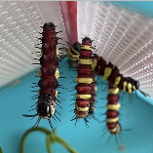
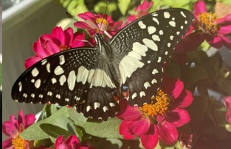
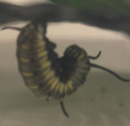

Life cycle of Lime Butterfly
Instruction
After receiving the kit. Put the host plant in refrigerator (Vegetable box). Be careful of ants, do not leave the box opened. Keep the box in cool and dry room (A/C is the best), do not put the box in direct sunlight
Egg stage 3-5 days, Depending on temperature, typically hatched in 3-5 days
Caterpillar Stage 6-12 days, Larva has black color. It will eat its own eggshell, then it will molt for 4-5 times. Last stage of caterpillar has green color.
Pupal stage 9-11 days, at this stage, the caterpillars stop eating and curl up
Butterfly stage 10 -15 days, When butterflies come out of their pupas, their wings are wet. It will need to get dry in first 1-2 Hr., Do not touch them at this moment. Wait them to dry their wings properly. Usually, they come out in the morning, so please check them regularly.
Lime
Butterfly
Keep the box Clean by empty stool and change the paper everyday. Dirty box leads the mold, and it makes caterpillars get sick and die.
Caterpillars can be touched. No itchy caused. However, please be gentle with them. Do not try to touch them when they are molting or turning into pupa. They will curl up and look like below pictures.
Tips: dip your finger in syrup or sweet fruit juice, butterflies will climb to your finger easily. After taking photos, let them go by leaving them around a tree.
If the caterpillar is accidentally fallen to the bottom of the box during transformation, do not touch the caterpillar until it’s completely turn into pupa (approximately 1 day). After that, it can be moved when cleaning, then put it back in the bottom of the box. Put some branch to help it climbs up when it’s becoming butterfly.

Slide 2
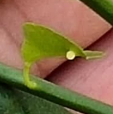
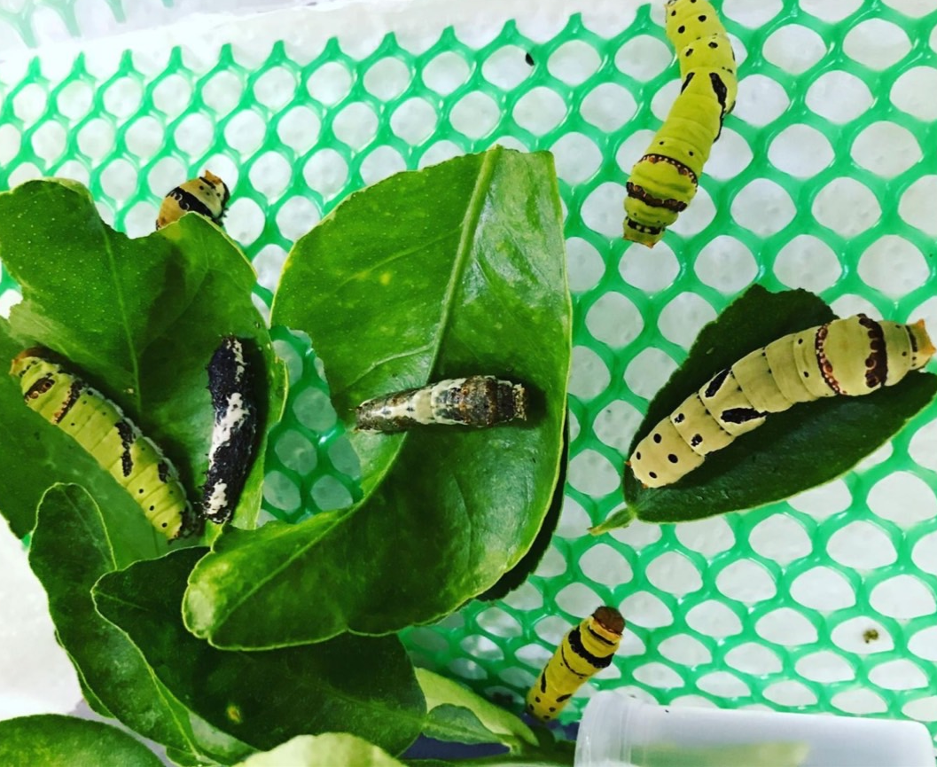
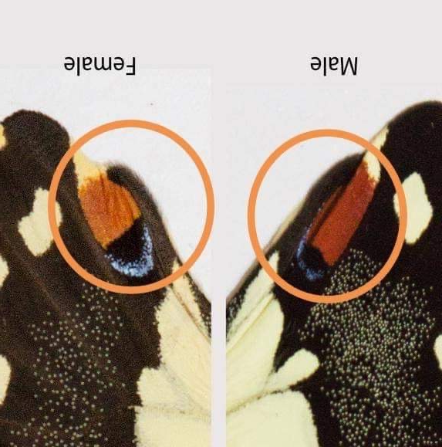
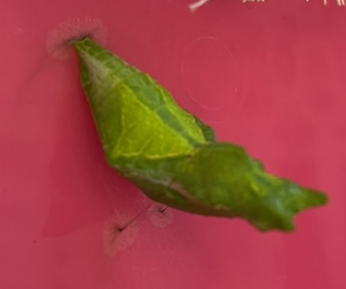
Egg stage
3-5 days
IG: TheVeryHungryCaterpillarHouse
FB: บ้านหนอนผีเสื้อเพื่อการเรียนรู้
Caterpillar stage
6-12 days
The Very Hungry Caterpillar House
Bottom wings
Butterfly stage
10-15days
Pupal Stage
9-11 days
Life cycle of Lime Butterfly

