Slide 1
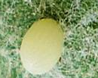
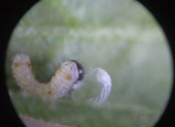
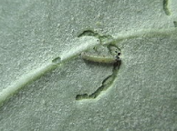
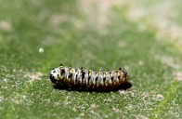
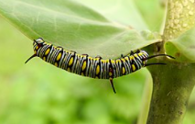
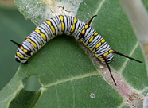
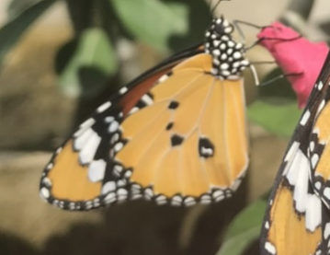
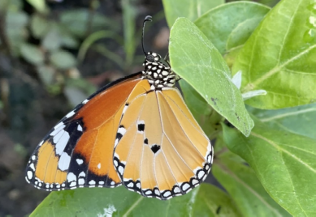
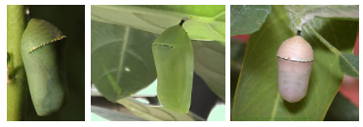
Life Cycle of Butterfly
Plain Tiger/African Queen/African Monarch
(Danaus Chrysippus)
Caterpillar Stage
5 instar stages: 11-15 Days
FB: @TheVeryHungryCaterpillarHouse
Egg Stage
Depending on temperature, typically hatched in 3-5 days
Larva eating its own eggshell
Caterpillar making "moat" to feed during the first instar
Second instar
Mature caterpillar
Older
caterpillar
Adult stage
7-14 Days
Pupal Stage
6-8 Days
Before pupation, the caterpillar will become motionless and cease feeding. Its color shifts slightly from gray to brown, and it may lose a small amount of body mass. The pupal changes color over this period from a pale green to dark brown.
male
female

